Slide 2
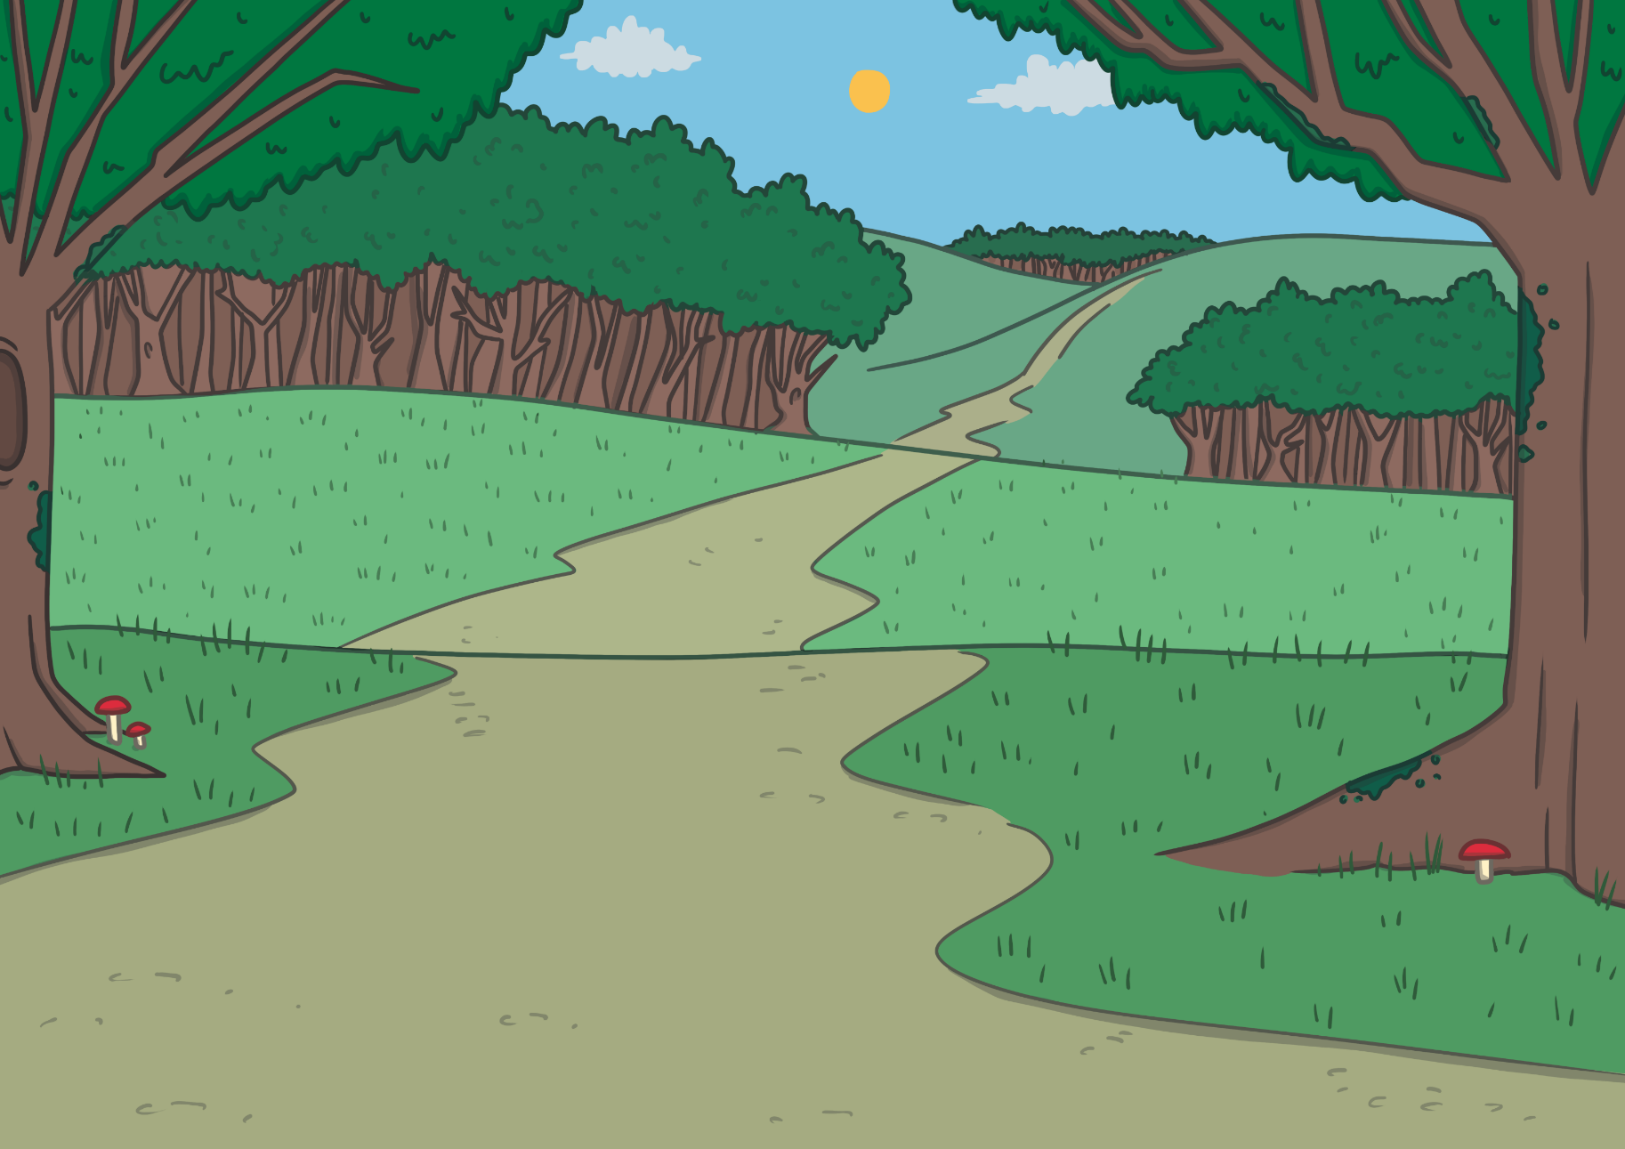
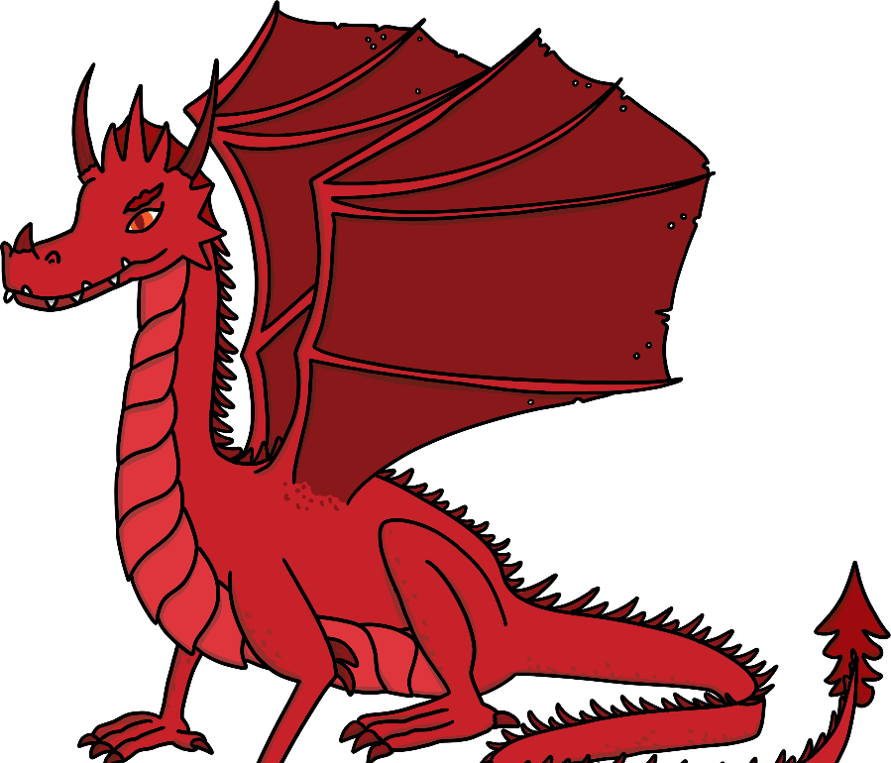
A long time ago, a red dragon lived in the Cambrian mountains. This was a quiet, lovely place, full of magic.
He was a lovely dragon. He looked after the people who lived in this area and everyone loved him very much.

Slide 3
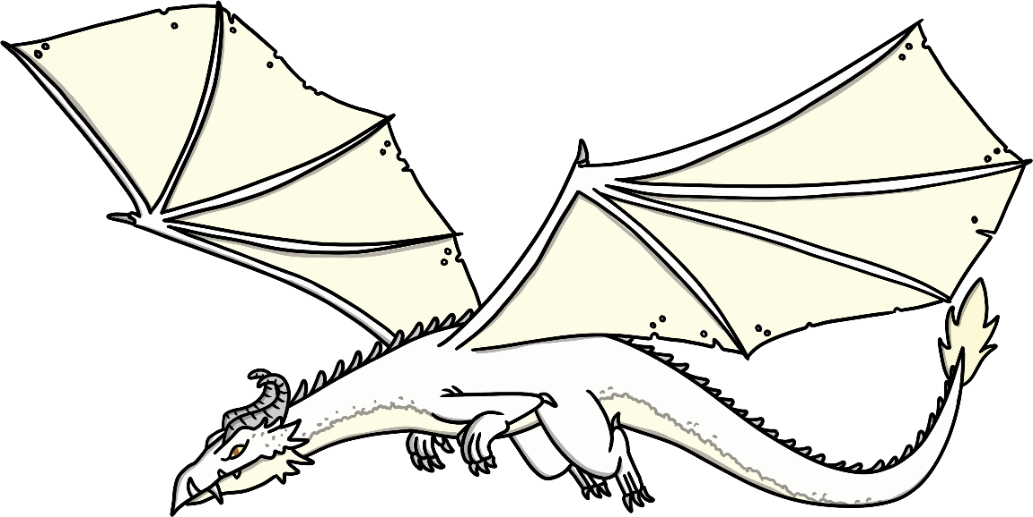
One day, a white dragon flew into this beautiful area. This dragon was not so nice.

Slide 4
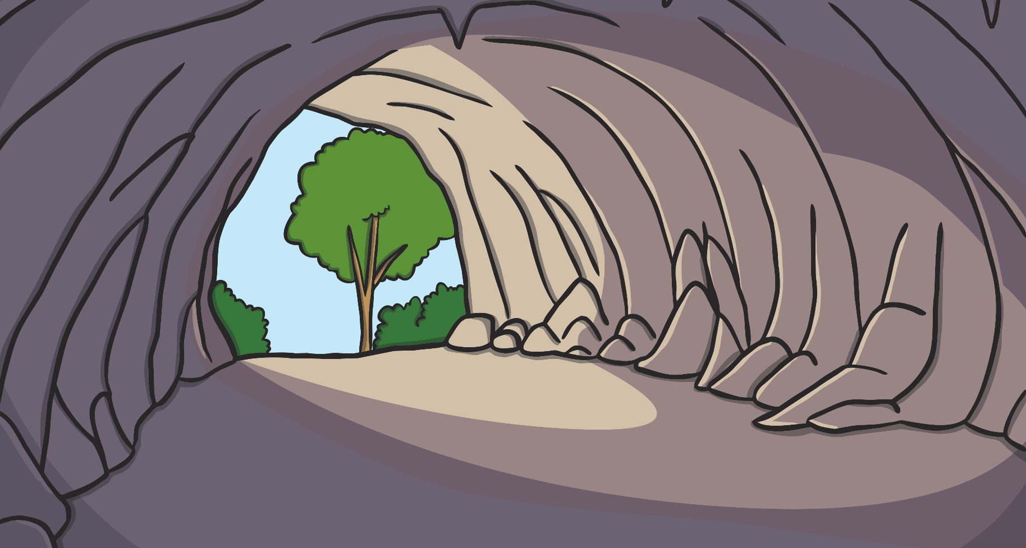

The red dragon had been asleep in his cave. When he woke, he looked out of the cave and saw the white dragon flying through the air.

Slide 5


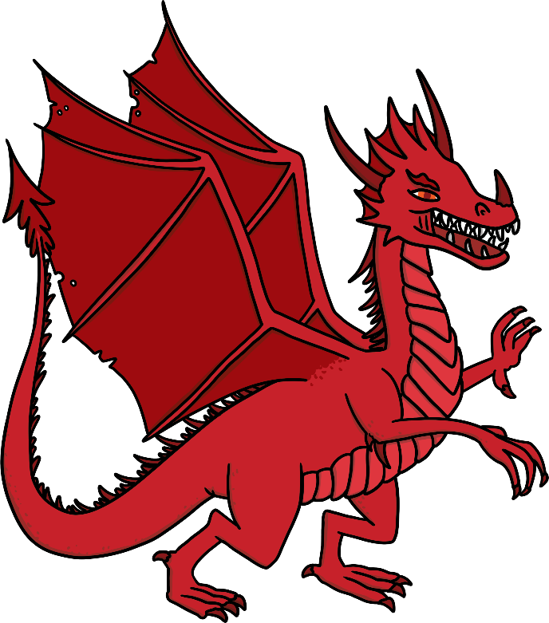
The white dragon felt that he owned this place but the red dragon loved this area very much and was going to protect it at all costs.

Slide 6



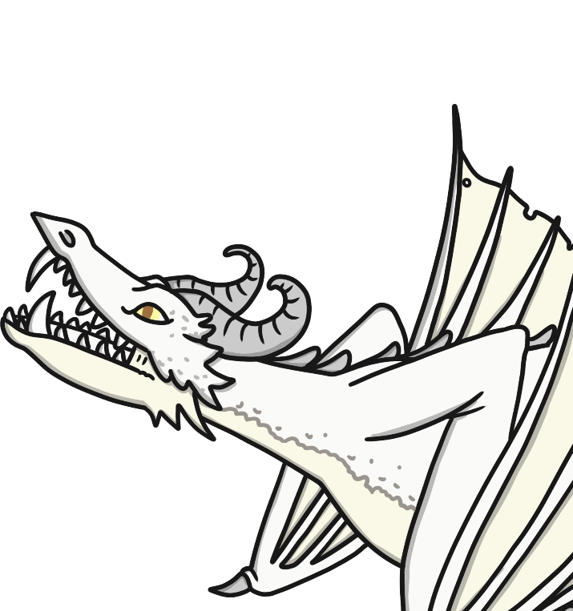
The two dragons rose to the air and started fighting with all their strength. The flames and the smoke from the two dragons could be seen across the whole country and a deafening noise filled the air.

Slide 7
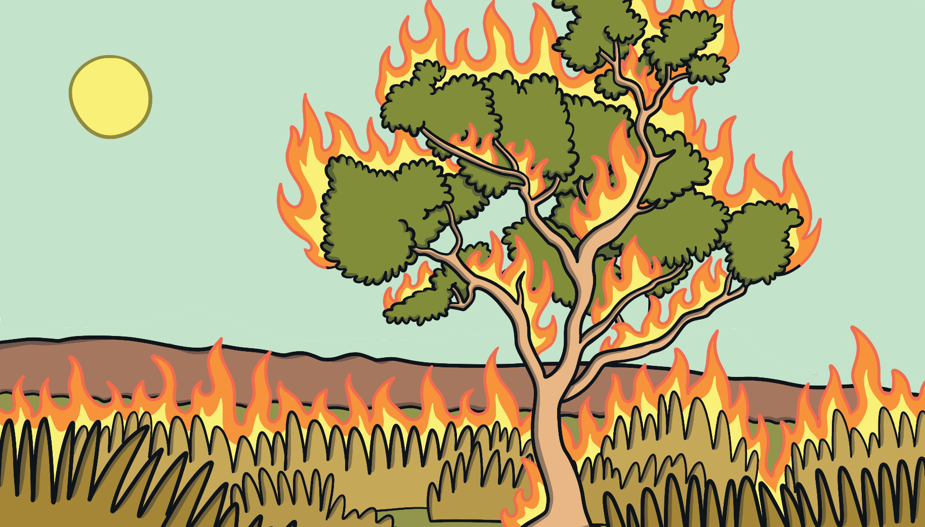
The people were scared. The fighting of the dragons caused the ground to dry up and crack.

Slide 8

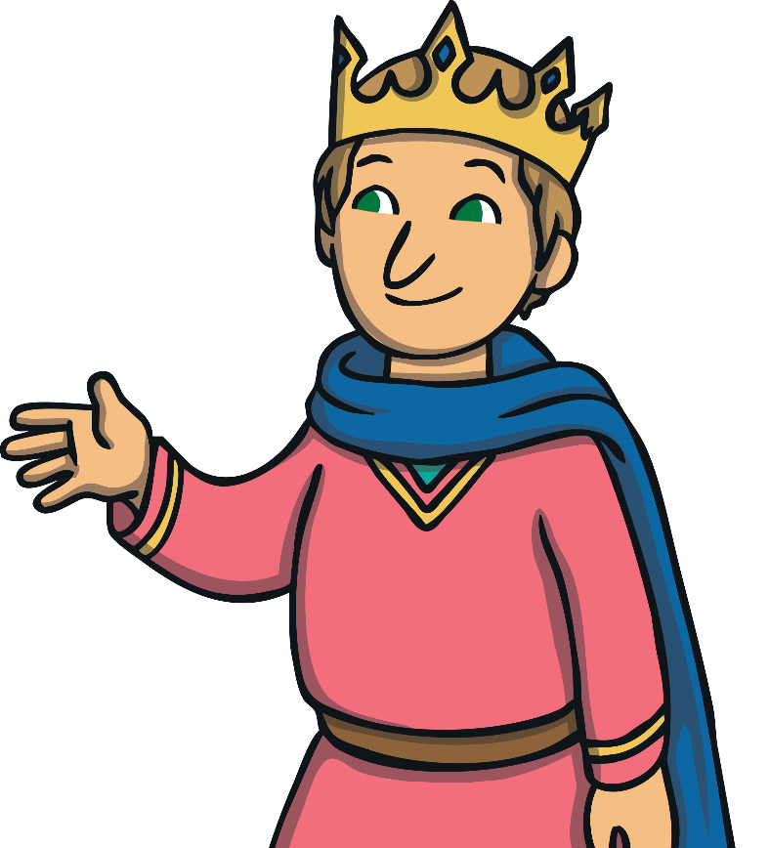
The King at the time was King Lludd. He didn't know what to do. He decided to go to France where his brother, Llefelys, was king. He would surely know what he could do to help.

Slide 9
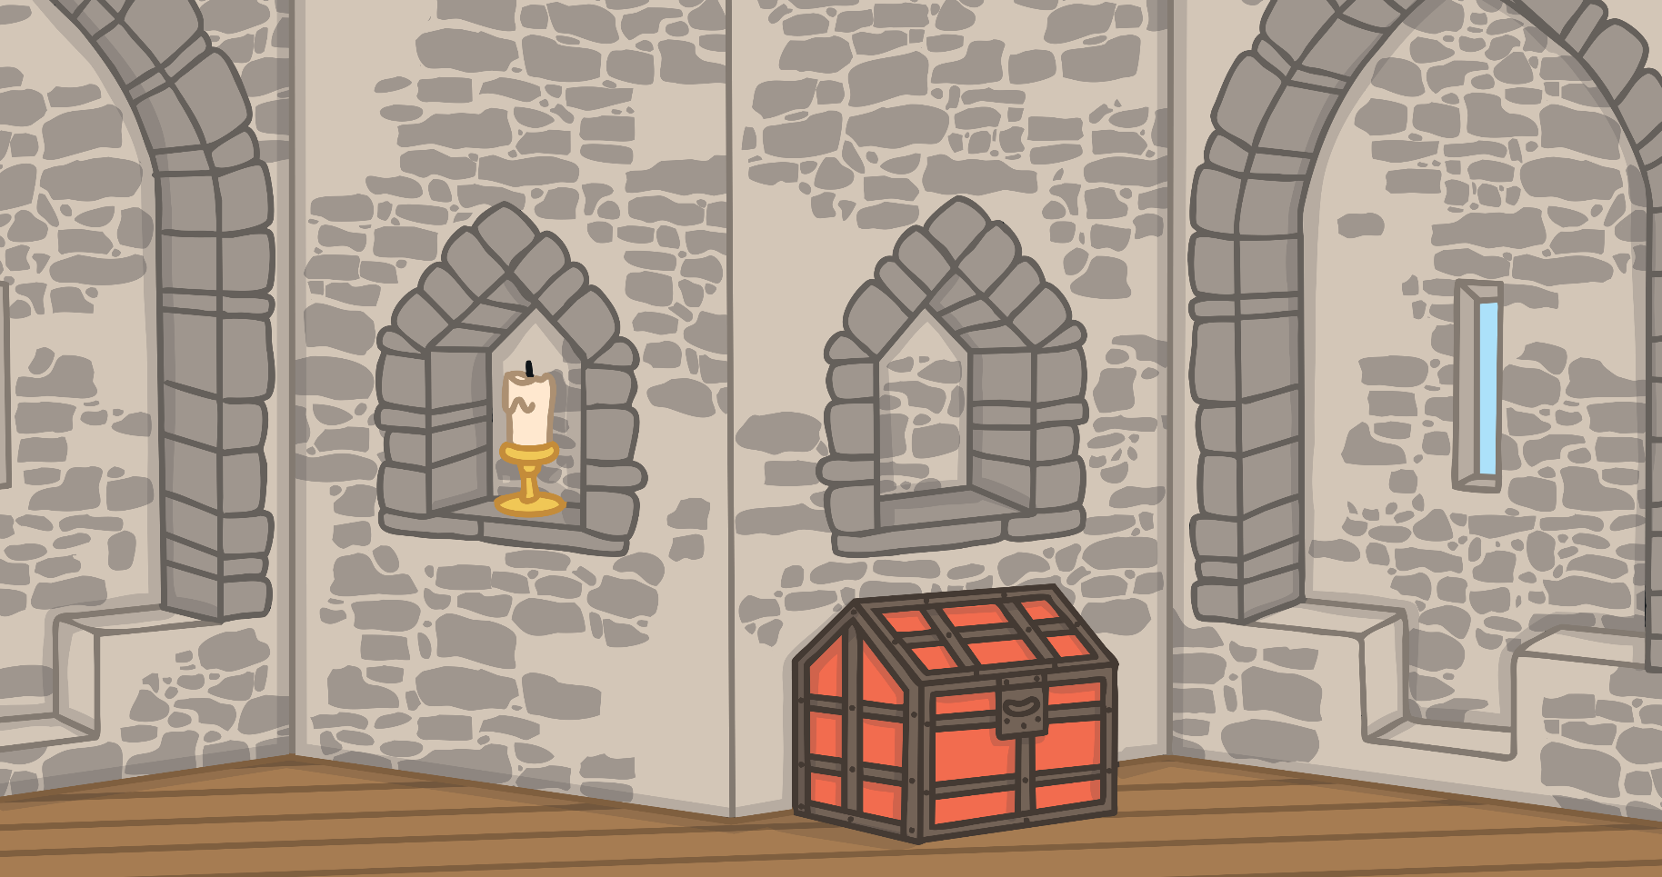
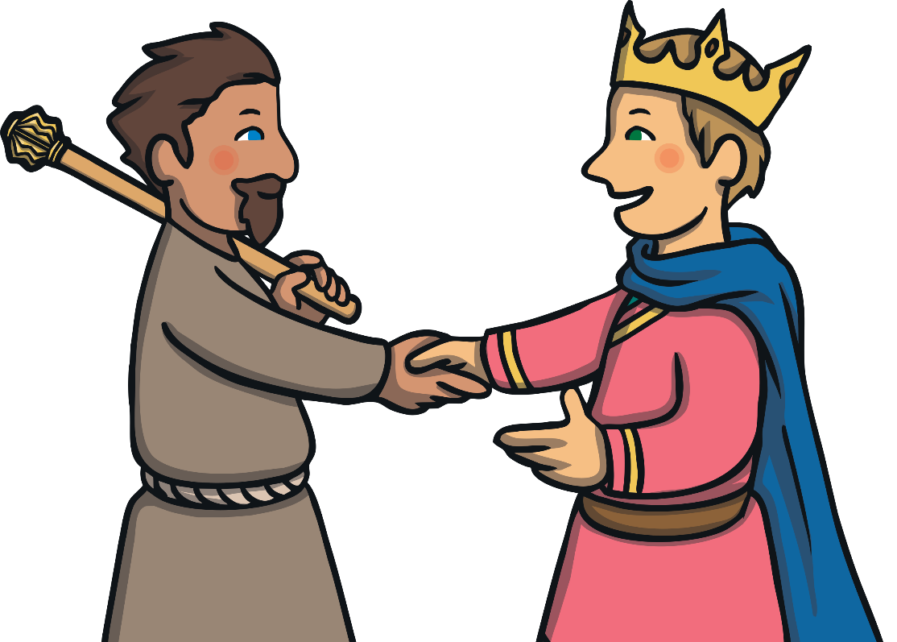
The two brothers spoke for hours. Llefelys agreed that it would not be possible for the red dragon to win against the white dragon, but then, he had an idea.

Slide 10
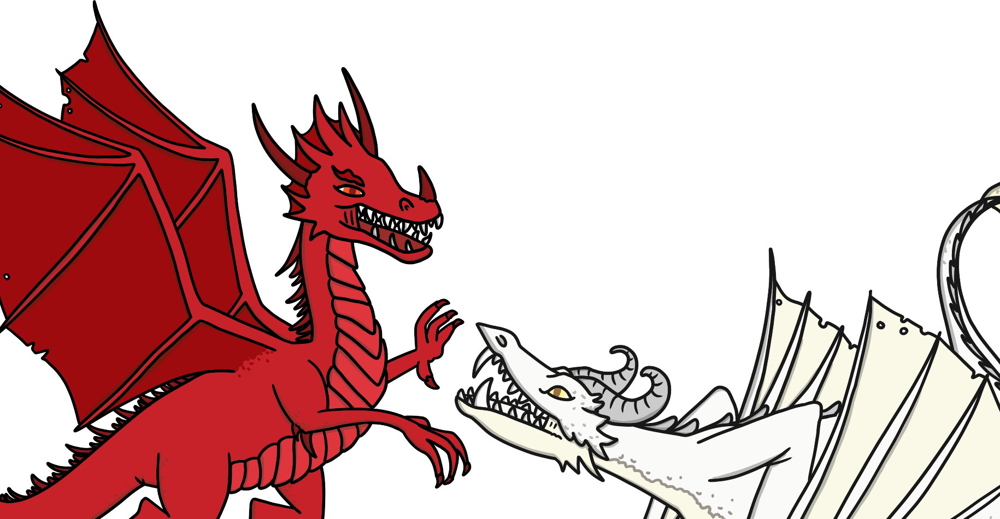

When King Lludd came home, he told his men to dig a deep pit and fill it with mead. The dragons, exhausted from their fighting fell into the pit. They drank the mead and fell asleep heavily.

Slide 11
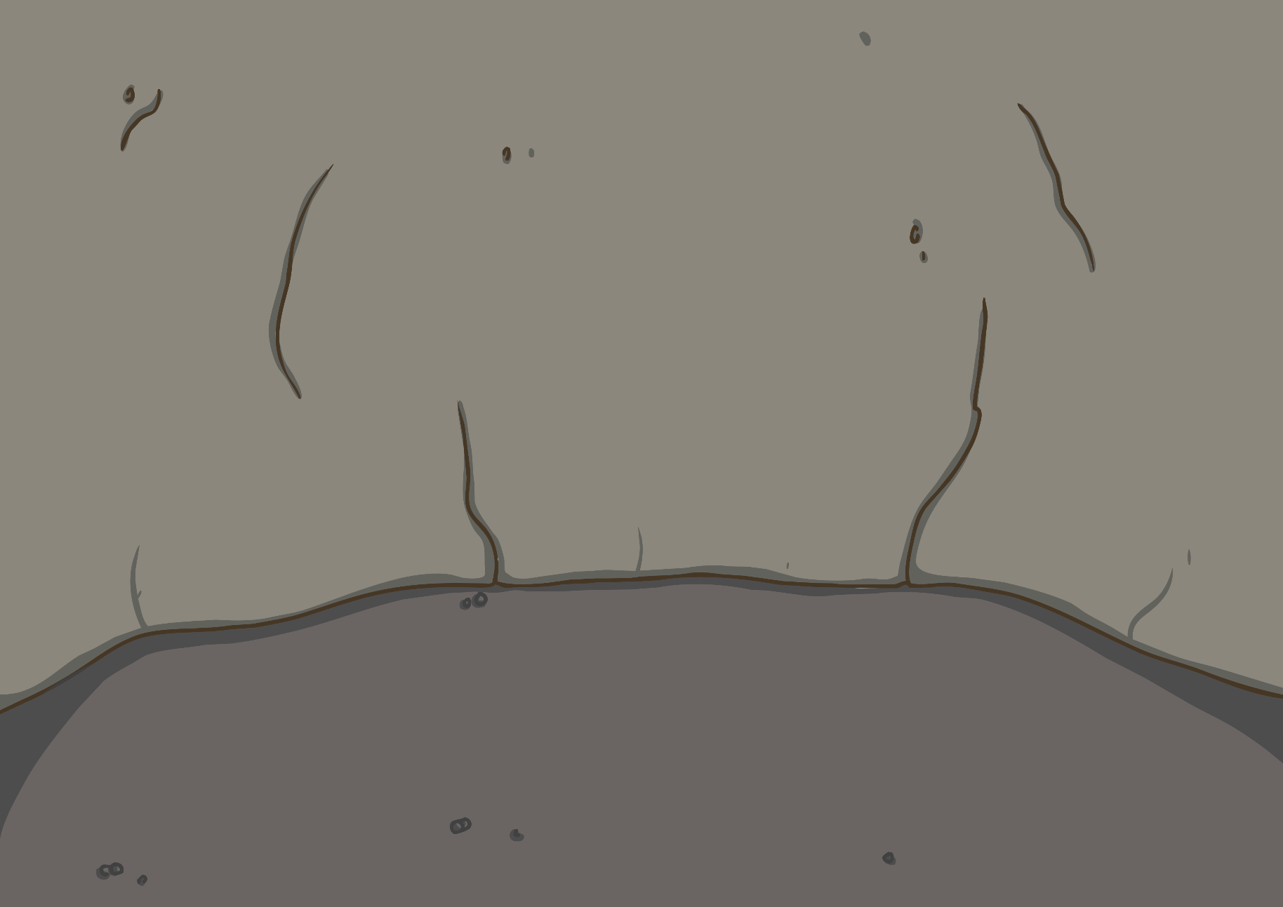
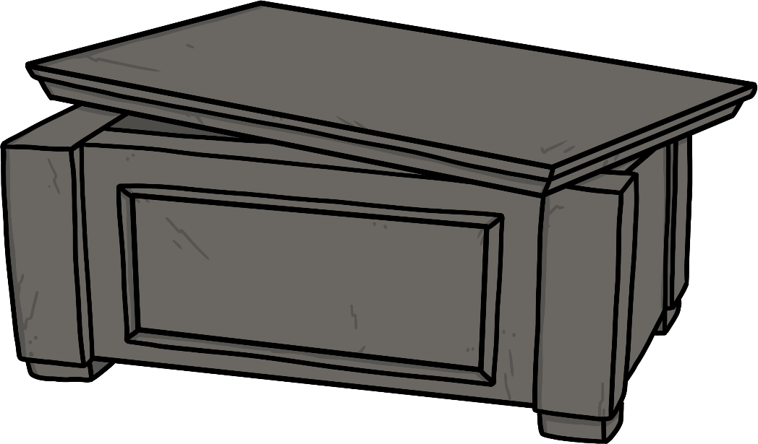
Soldiers bound the two dragons and carried them away to a place called Dinas Emrys, in Snowdonia. They put the dragons in a chest made of stone and buried them in a dark cave underground.
The dragons were quiet for years…

Slide 12
Years later, Vortigern, King of Gwynedd came to Dinas Emrys to build a tower. Every night, his tower would collapse. Vortigern didn't know what to do, so he asked his wizards for help.
The wizards told King Vortigern that he must find a boy to sacrifice.

Slide 13
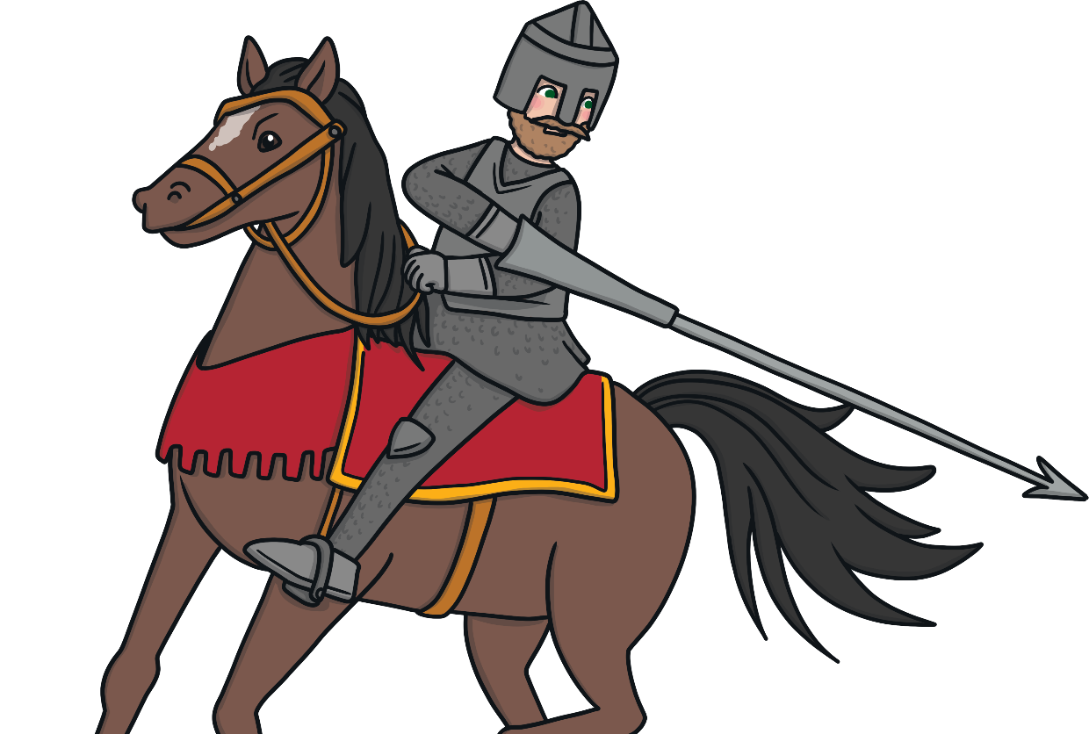
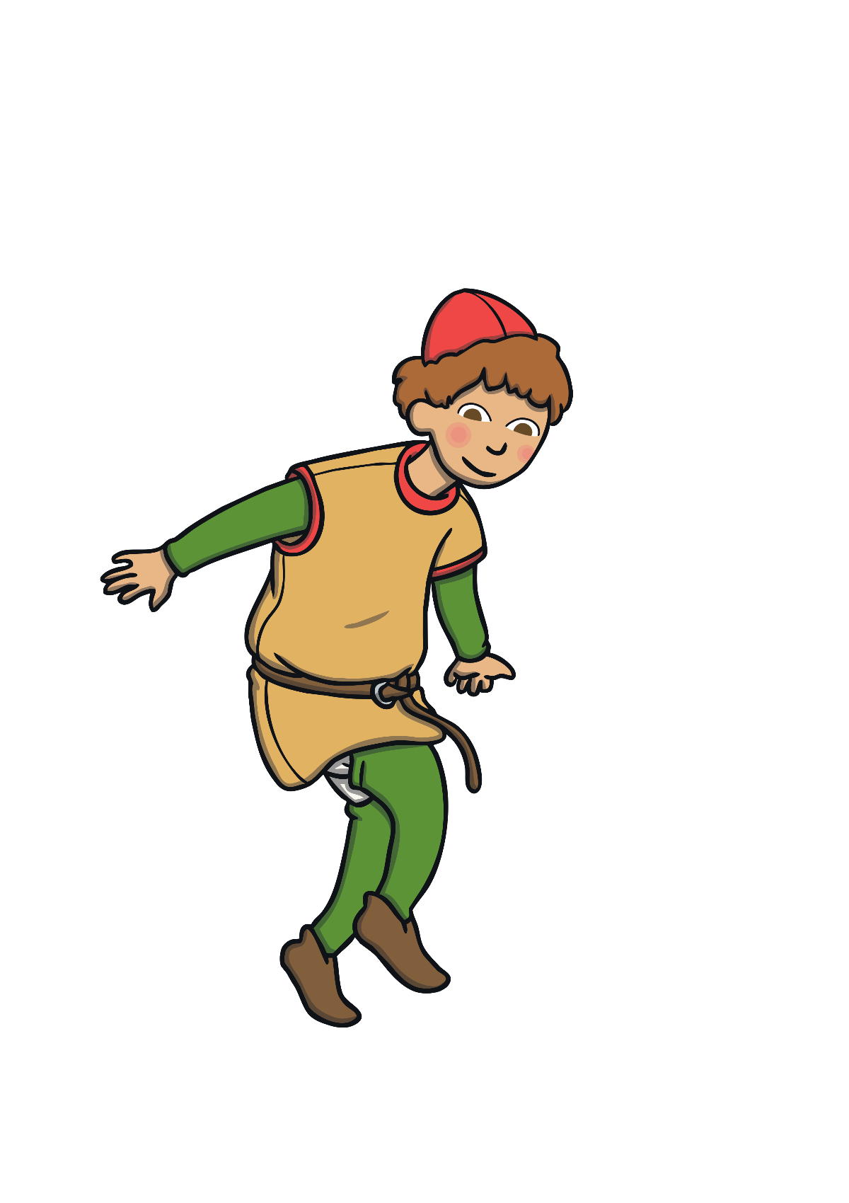
Vortigern's men travelled a long way in search of a boy. They found him in a place called Carmarthen, in West Wales. He lived with his mother and his name was Merlin.

Slide 14
Merlin was a wise and clever boy. He knew what King Vortigern's plan was. Merlin said he knew why the King couldn't build a tower at Dinas Emrys and suggested that the King should ask his wizards to tell him what lived in a cave deep in the ground beneath them.

Slide 15

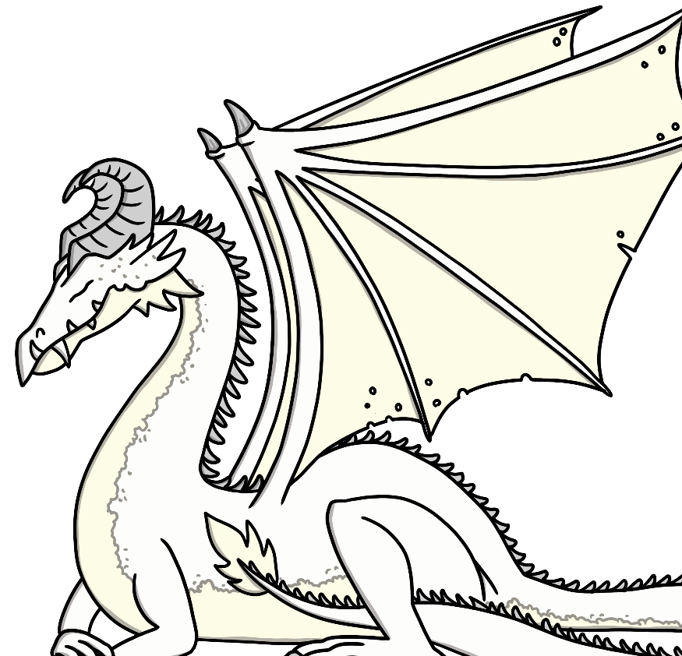
Vortigern sent his men down to the cave to see if Merlin's story was true. They found a chest made of stone. When they opened the chest, they saw the two dragons sleeping side by side.

Slide 16

As soon as the chest was opened, the two dragons flew out and started fighting again.
The red dragon finally defeated the white dragon and there was peace again.

